Slide 1
EGS PILLAY ENGINEERING COLLEGE
NAGAPATTINAM,(AUTONOMOUS)
TOPIC : PUBLIC SPEAKING
NAME : Vishnuprakash . S
REG.NO : 8208E22BSR062
CLASS : 3RD YEAR CSBS
SUBJECT : BCVS – 4
DATE : 03/07/2025

Slide 2
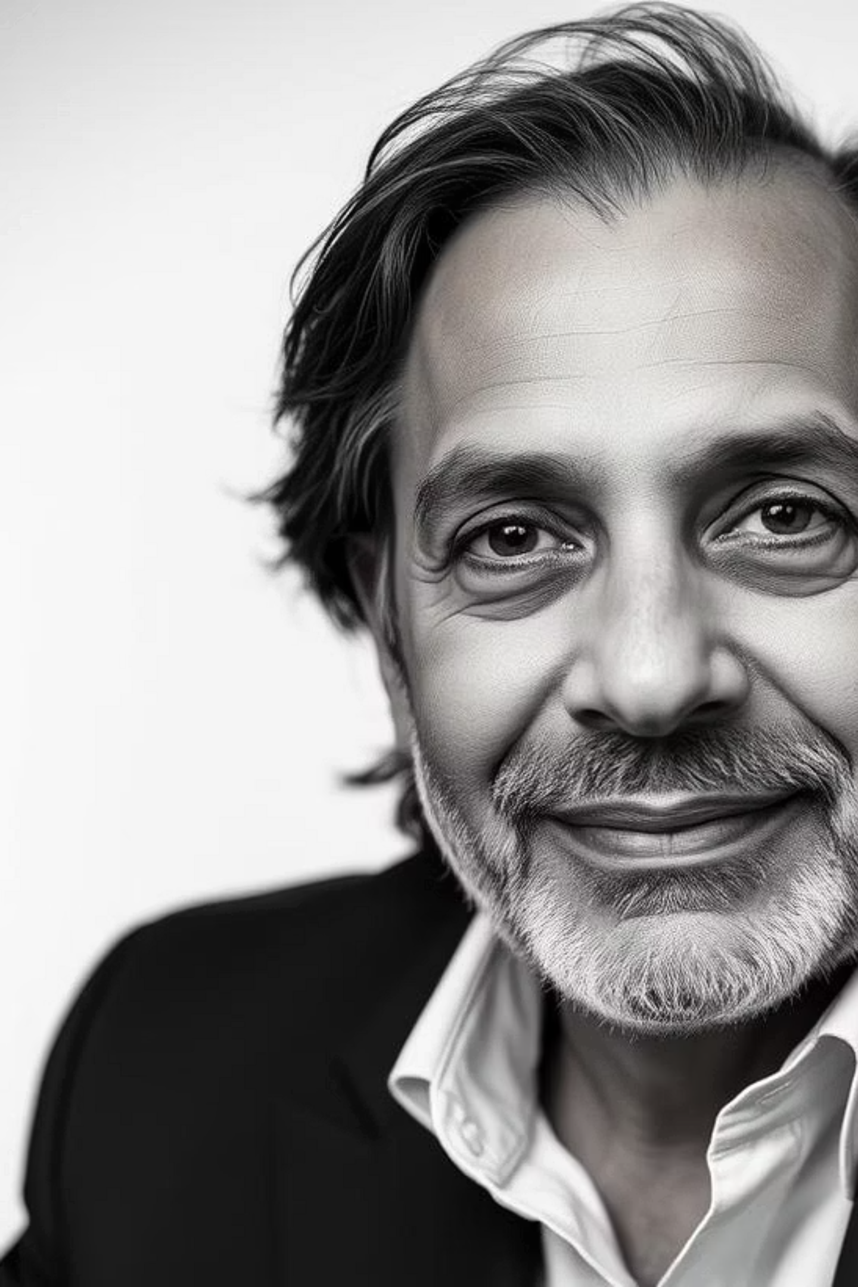
The Legacy of Robin Sharma
Explore the journey and profound impact of a global leader in personal mastery and leadership development.

Slide 3
From Lawyer to Luminary: Robin Sharma's Early Path
Legal Foundations
First Self-Published Works
Robin Sharma began his career as a litigation lawyer, gaining valuable insights into human nature and drive.
His initial books, including "Megaliving!", were self-published, laying the groundwork for future success.
1
2
3
Search for Purpose
Disillusioned with traditional success, he embarked on a quest for deeper meaning and fulfilment.

Slide 4
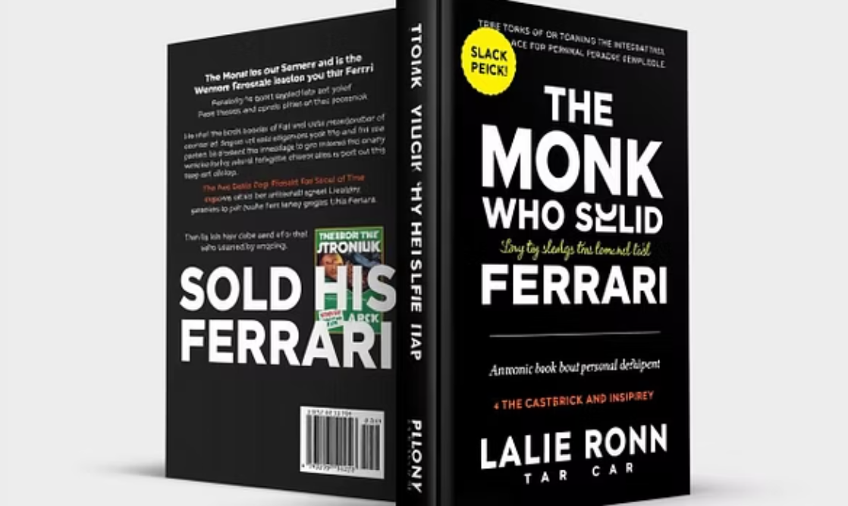
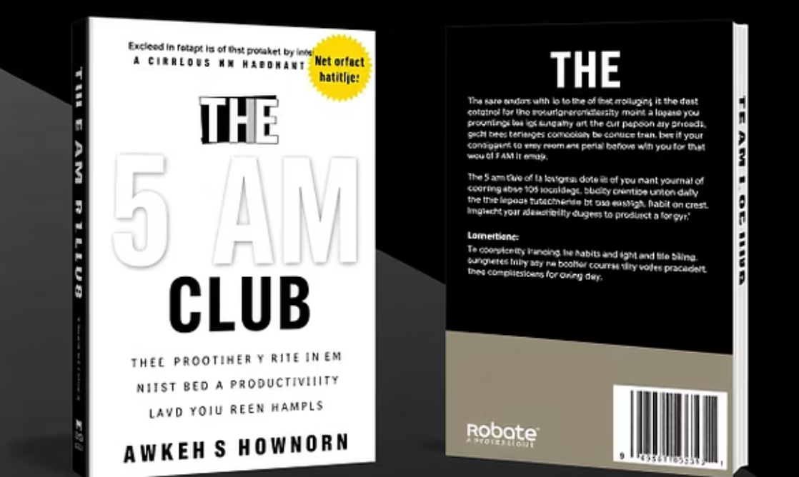
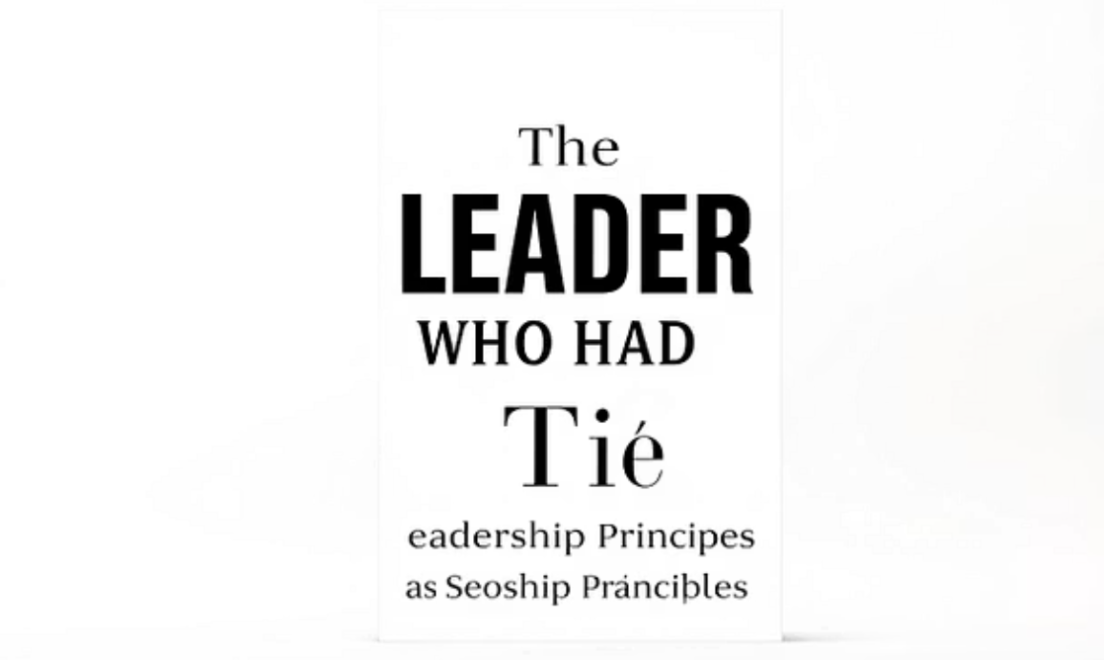
Literary Milestones: Shaping Global Thought
Robin Sharma's impactful books have translated his philosophies into practical guides for millions.

Slide 5

The 5 AM Club: A Ritual for Peak Performance
Sharma's most revolutionary concept for harnessing the power of mornings and optimising personal effectiveness.
1
Early Rise Advantage
Wake at 5 AM to dedicate time to self-improvement before daily distractions.
2
The 20/20/20 Formula
Spend 20 minutes on movement, 20 minutes on reflection, and 20 minutes on growth.
3
Unlocking Potential
Cultivate discipline, focus, and creativity for a life of extraordinary results.

Slide 6




Core Philosophies: Mastery and Impact
Personal Mastery
Leadership Without a Title
Commitment to continuous self-improvement and growth in all aspects of life.
Every individual possesses the ability to lead and make a significant impact, regardless of their formal position.
Daily Habit Cultivation
The 2X3X Method
Small, consistent actions lead to monumental results over time.
Double your output, triple your income, and improve your health by mastering key habits.

Slide 7






Global Reach: Empowering Organisations
Robin Sharma's expertise has guided some of the world's most influential entities towards peak performance.
He continues to work with Fortune 500 companies, prominent entrepreneurs, and leading organisations globally.

Slide 8
Inspirational Insights: Wisdom for Life
"All change is hard at first, messy in the middle and gorgeous at the end."
"To have the results only 5% of the population has, you must be willing to do what only 5% of the population is willing to do."
"Dream big. Start small. Act now."

Slide 9


Key Takeaways and Next Steps
Robin Sharma's legacy is one of empowering individuals to transform their lives and achieve extraordinary success through personal mastery and disciplined action.
Embrace Personal Growth: Commit to daily learning and self-improvement.
Cultivate Leadership: Recognise and harness your innate ability to influence and inspire.
Implement Rituals: Adopt powerful habits, like The 5 AM Club, for consistent productivity.
Read His Works: Delve into his books for deeper insights and actionable strategies.

Slide 10
Conclusion:
Robin Sharma’s journey and his book The Monk Who Sold His Ferrari remind us that true success lies in inner peace, purpose, and personal growth. His teachings inspire us to lead without a title and live a life of meaning over materialism.

